Slide 1
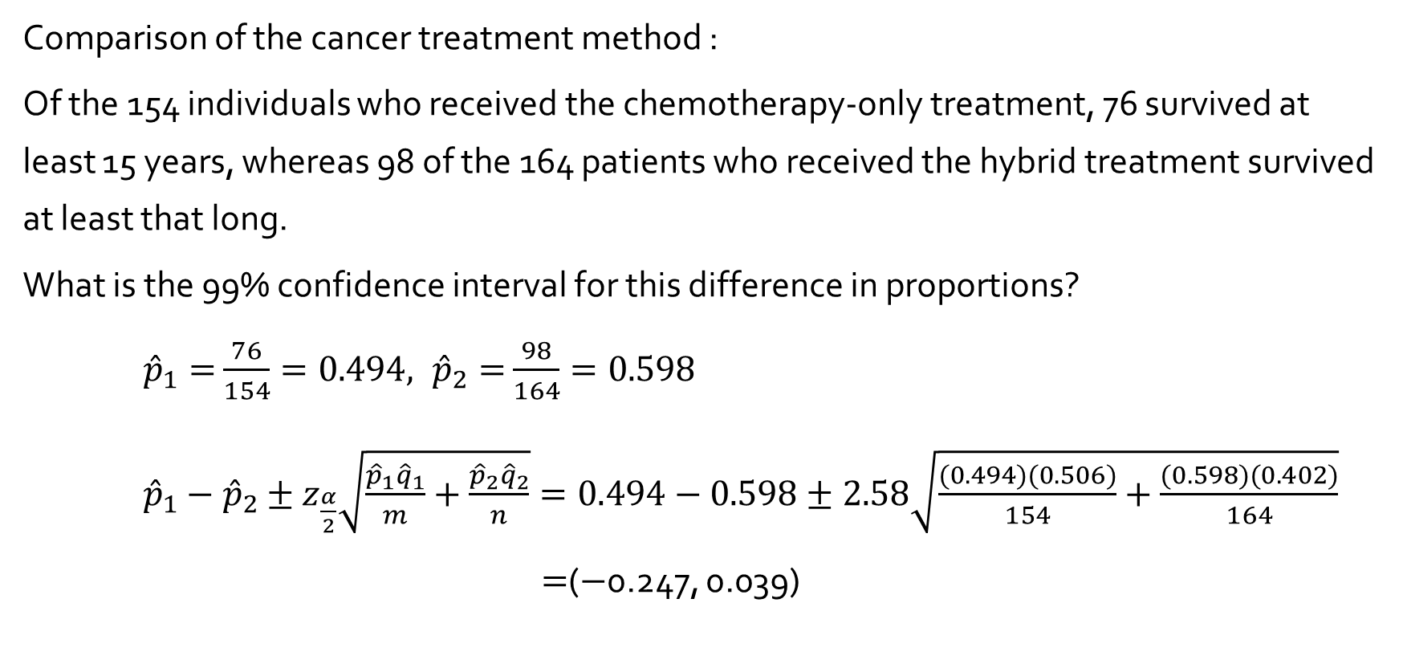
Example 9.12
Comparison of the cancer treatment method :
Of the 154 individuals who received the chemotherapy-only treatment, 76 survived at least 15 years, whereas 98 of the 164 patients who received the hybrid treatment survived at least that long.
What is the 99% confidence interval for this difference in proportions?
${\hat{p}}_{1}=$ $\frac{76}{154}=0.494, {\hat{p}}_{2}=$ $\frac{98}{164}=0.598$
${\hat{p}}_{1}−{\hat{p}}_{2}±z_{\frac{α}{2}}\sqrt{\frac{{\hat{p}}_{1}{\hat{q}}_{1}}{m}+\frac{{\hat{p}}_{2}{\hat{q}}_{2}}{n}}=0.494−0.598±2.58\sqrt{\frac{(0.494)(0.506)}{154}+\frac{(0.598)(0.402)}{164}}$
$=$($−$0.247, 0.039)

Slide 2
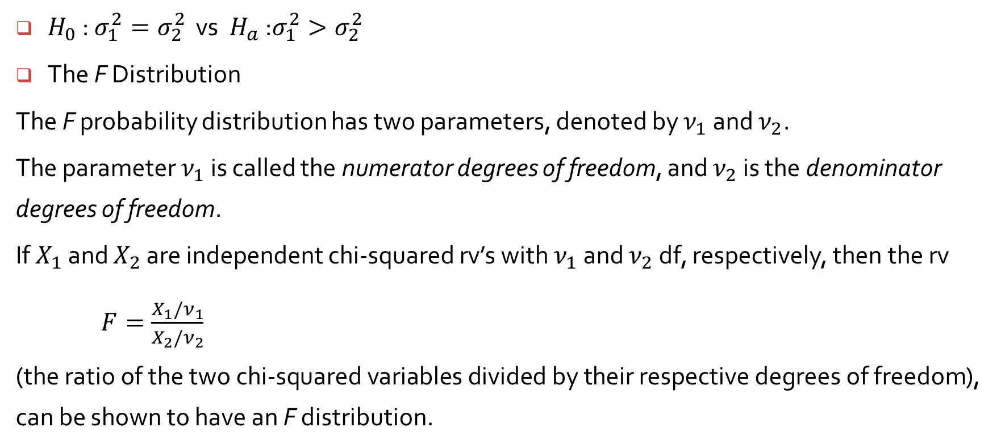
Inference Concerning Two Population Variances
$H_{0}$ : $σ_{1}^{2}=σ_{2}^{2}$ vs ${ H}_{a}$ :$σ_{1}^{2}>σ_{2}^{2}$
The F Distribution
The F probability distribution has two parameters, denoted by $ν_{1}$ and $ν_{2}$.
The parameter $ν_{1}$ is called the numerator degrees of freedom, and $ν_{2}$ is the denominator degrees of freedom.
If $X_{1}$ and $X_{2}$ are independent chi-squared rv’s with $ν_{1}$ and $ν_{2}$ df, respectively, then the rv
$F=\frac{X_{1}/ν_{1}}{X_{2}/ν_{2}}$
(the ratio of the two chi-squared variables divided by their respective degrees of freedom), can be shown to have an F distribution.

Slide 3
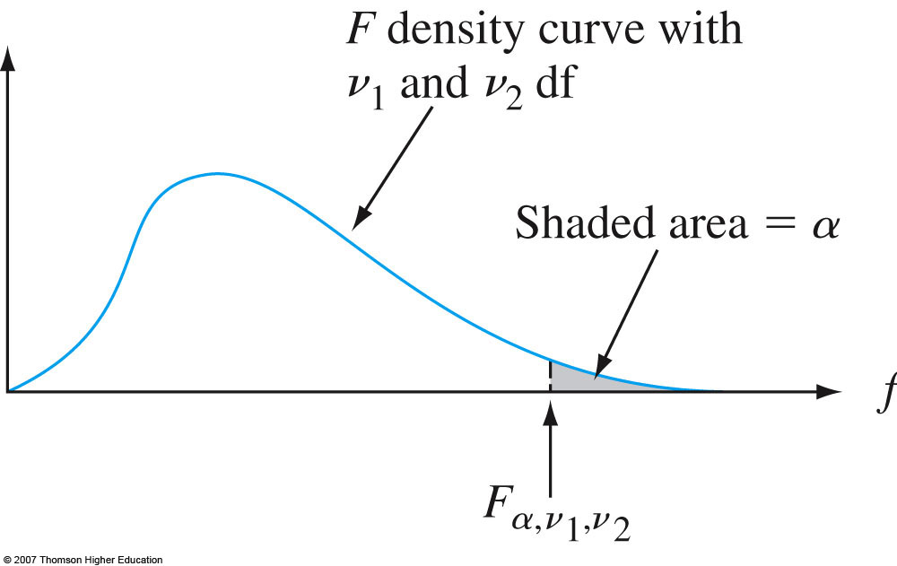
Fig. 9-8, p. 360
Notes:
Figure 9.8
An F density curve and critical value.

Slide 4
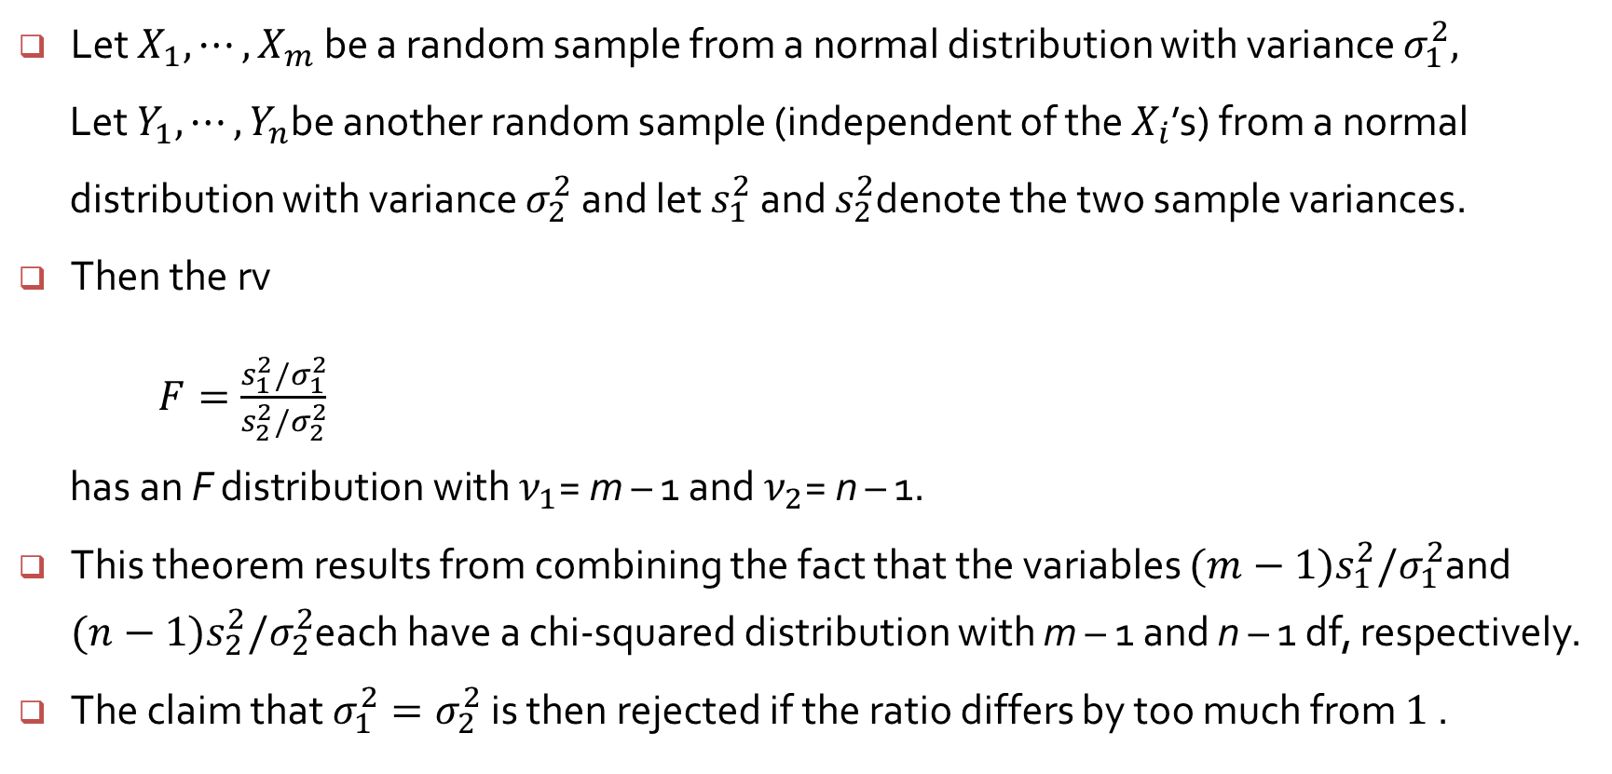
The F Test for Equality of Variances
Let $X_{1}, ⋯,X_{m}$be a random sample from a normal distribution with variance $σ_{1}^{2},$
Let $Y_{1}, ⋯,Y_{n}$be another random sample (independent of the $X_{i}$’s) from a normal
distribution with variance $σ_{2}^{2}$ and let $s_{1}^{2}$ and $s_{2}^{2}$denote the two sample variances.
Then the rv
$F=\frac{s_{1}^{2}/σ_{1}^{2}}{s_{2}^{2}/σ_{2}^{2}}$
$\text{has} \text{an} \text{F} \text{distribution} \text{with} ν_{1}\text{= }\text{m} \text{– 1 }\text{and}{ ν}_{2}\text{= }\text{n} \text{– 1.}$
This theorem results from combining the fact that the variables ${(m−1)s}_{1}^{2}/σ_{1}^{2}$and ${(n−1)s}_{2}^{2}/σ_{2}^{2}$each have a chi-squared distribution with m – 1 and n – 1 df, respectively.
The claim that $σ_{1}^{2}=σ_{2}^{2}$ is then rejected if the ratio differs by too much from $1$.

Slide 5
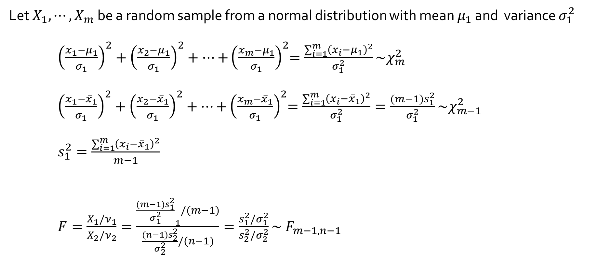
The F Test for Equality of Variances
Let $X_{1}, ⋯,X_{m}$be a random sample from a normal distribution with mean $μ_{1}$ and variance $σ_{1}^{2}$
${\left(\frac{x_{1}−μ_{1}}{σ_{1}}\right)}^{2}+{\left(\frac{x_{2}−μ_{1}}{σ_{1}}\right)}^{2}+⋯{+\left(\frac{x_{m}−μ_{1}}{σ_{1}}\right)}^{2}=\frac{\sum_{i=1}^{m}{{\left(x_{i}−μ_{1}\right)}^{2}}}{σ_{1}^{2}}\sim χ_{m}^{2}$
${\left(\frac{x_{1}−{\overline{x}}_{1}}{σ_{1}}\right)}^{2}+{\left(\frac{x_{2}−{\overline{x}}_{1}}{σ_{1}}\right)}^{2}+⋯{+\left(\frac{x_{m}−{\overline{x}}_{1}}{σ_{1}}\right)}^{2}=\frac{\sum_{i=1}^{m}{{\left(x_{i}−{\overline{x}}_{1}\right)}^{2}}}{σ_{1}^{2}}=\frac{{(m−1)s}_{1}^{2}}{σ_{1}^{2}}\sim χ_{m−1}^{2}$
$s_{1}^{2}=\frac{\sum_{i=1}^{m}{{\left(x_{i}−{\overline{x}}_{1}\right)}^{2}}}{m−1}$
$F=\frac{X_{1}/ν_{1}}{X_{2}/ν_{2}}=\frac{{\frac{{(m−1)s}_{1}^{2}}{σ_{1}^{2}}}_{1}/(m−1)}{\frac{{(n−1)s}_{2}^{2}}{σ_{2}^{2}}/(n−1)}=\frac{s_{1}^{2}/σ_{1}^{2}}{s_{2}^{2}/σ_{2}^{2}}\sim { F}_{m−1, n−1}$

Slide 6
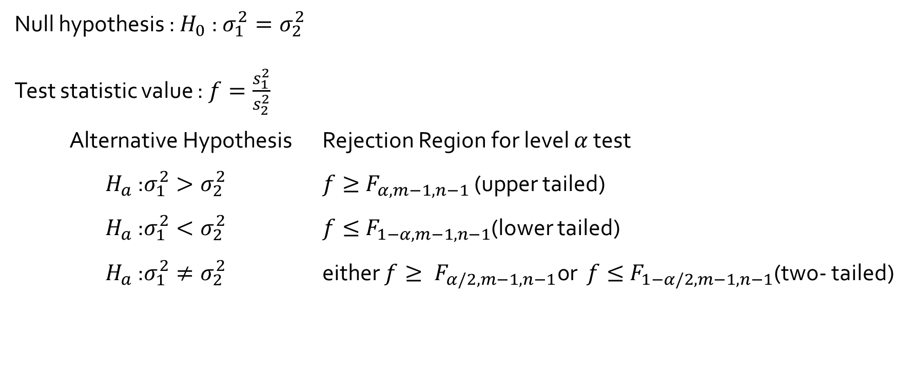
The F Test for Equality of Variances
Null hypothesis : $H_{0}$ : $σ_{1}^{2}=σ_{2}^{2}$
Test statistic value : $f=\frac{s_{1}^{2}}{s_{2}^{2}}$
Alternative Hypothesis Rejection Region for level $α$ test
$H_{a}$ :$σ_{1}^{2}>σ_{2}^{2}$ $f≥{ F}_{α, m−1, n−1}$ (upper tailed)
$H_{a}$ :$σ_{1}^{2}<σ_{2}^{2}$ $f≤{ F}_{1−α, m−1, n−1}$(lower tailed)
$H_{a}$ :$σ_{1}^{2}≠σ_{2}^{2}$ either $f≥{ F}_{α/2, m−1, n−1}\text{or}$ $f≤{ F}_{1−α/2, m−1, n−1}$(two- tailed)

Slide 7
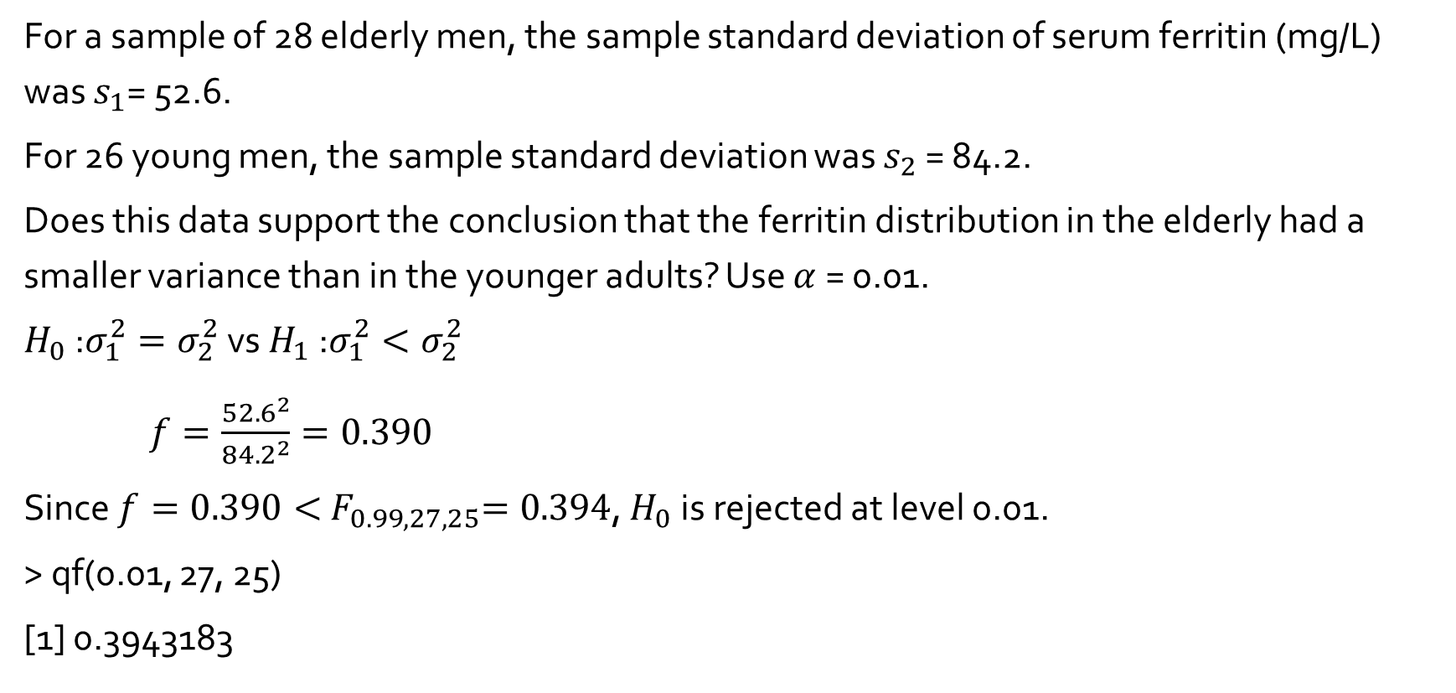
Example 9.14
For a sample of 28 elderly men, the sample standard deviation of serum ferritin (mg/L) was $s_{1}$= 52.6.
For 26 young men, the sample standard deviation was $s_{2}$ = 84.2.
Does this data support the conclusion that the ferritin distribution in the elderly had a smaller variance than in the younger adults? Use $α$ = 0.01.
$H_{0}$ :$σ_{1}^{2}=σ_{2}^{2}$ vs $H_{1}$ :$σ_{1}^{2}<σ_{2}^{2}$
$f=\frac{{52.6}^{2}}{{84.2}^{2}}=0.390$
Since $f=0.390<{ F}_{0.99, 27, 25}=0.394$, $H_{0}$ is rejected at level 0.01.
> qf(0.01, 27, 25)
[1] 0.3943183

